Slide 1

MRA Project ML 2
Samiullah SYED
PGPDSBA.O.FEB.C2021
net2sam@gmail.com

Slide 2
Agenda [Table OF CONTENT]
DATA Summary
EDA and Inference
Market Basket Analysis (Association Rules)
Recommendations - Possible Combos with Lucrative Offers

Slide 3
PROBLEM STATEMENT
A Grocery Store shared the transactional data with you. Your job is to identify the most popular combos that can be suggested to the Grocery Store chain after a thorough analysis of the most commonly occurring sets of items in the customer orders. The Store doesn’t have any combo offers. Can you suggest the best combos & offers?.
Grocery Store Data: dataset_group.csv

Slide 4
About data
• Data shape : 3 columns & 20641 rows.
• Columns :
1) Date – Order date (Date field) in DD-MM-YYYY format
2) Order_id – Order Number (Numeric)
3) Product – items or products in orders (Categorical)
• Unique values:
1) Date – 603
2) Order_id – 1139
3) Product - 37
• No. of Duplicates (before dropping) - 4730
• No Null / Missing rows

Slide 5

Tools Used - Python & Tableau
• EDA for the dataset is performed using Python
• Libraries used:
Pandas
Numpy
Seaborn
Matplotlib
TransactionEncoder
apriori
association_rules
EDA – Bi-Variate Analysis is done in Tableau tool – with the workflow published in Tableau public:
Samiullah Syed - MRA Project ML 2| Tableau Public

Slide 6
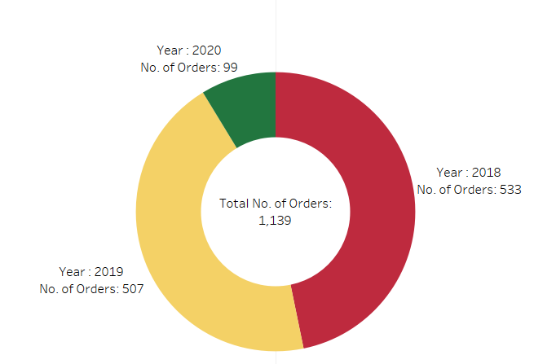
YEARLY TREND
The year 2018 has the highest no. of orders followed by 2019.
2020 is lowest (due to having only 2 months data)

Slide 7
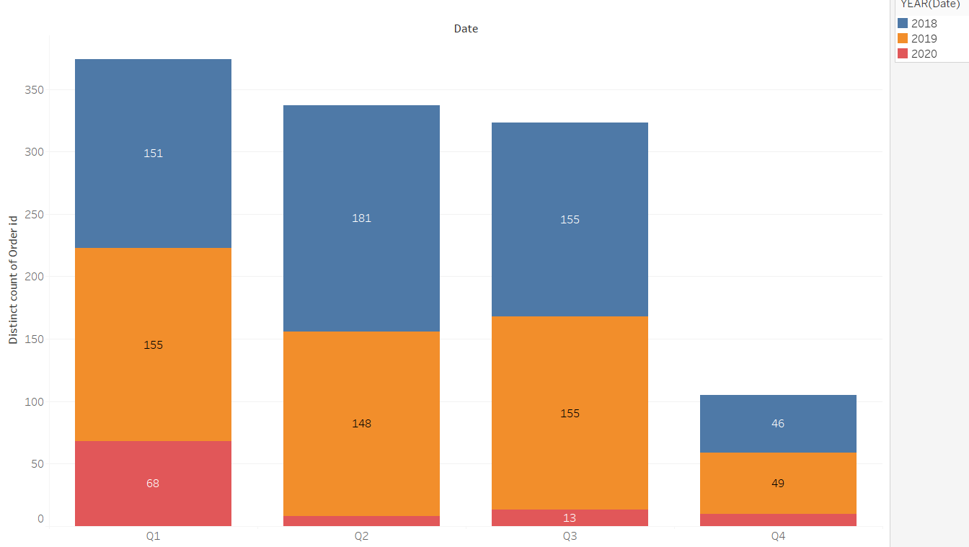
Quarterly trend
The Q1 2019 and Q2 2018 have the highest no of orders, and the lowest no of orders are in 2020 for all quarters since it contains only 2 months of data.

Slide 8
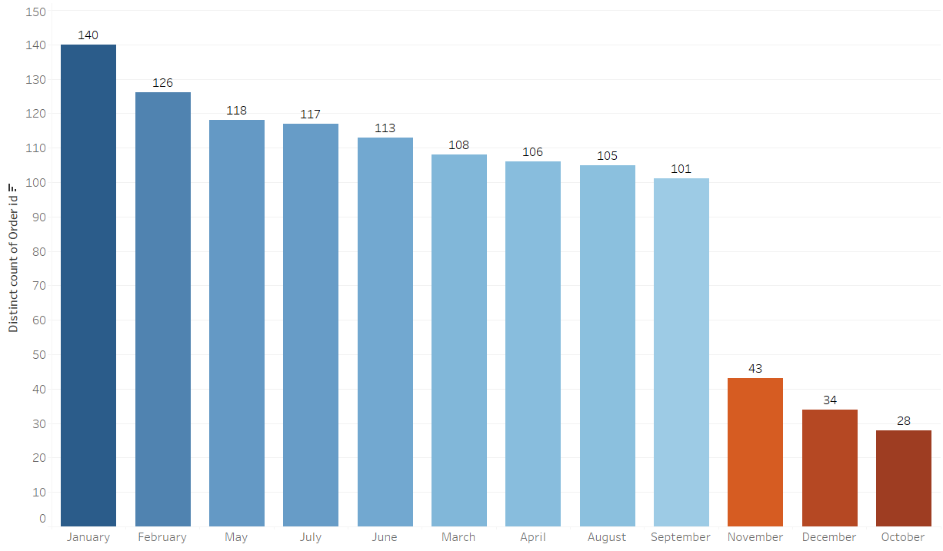
Monthly trend
Observed highest No. of unique orders placed during the month of Jan(140) and the lowest number of orders placed during month Oct(28)

Slide 9
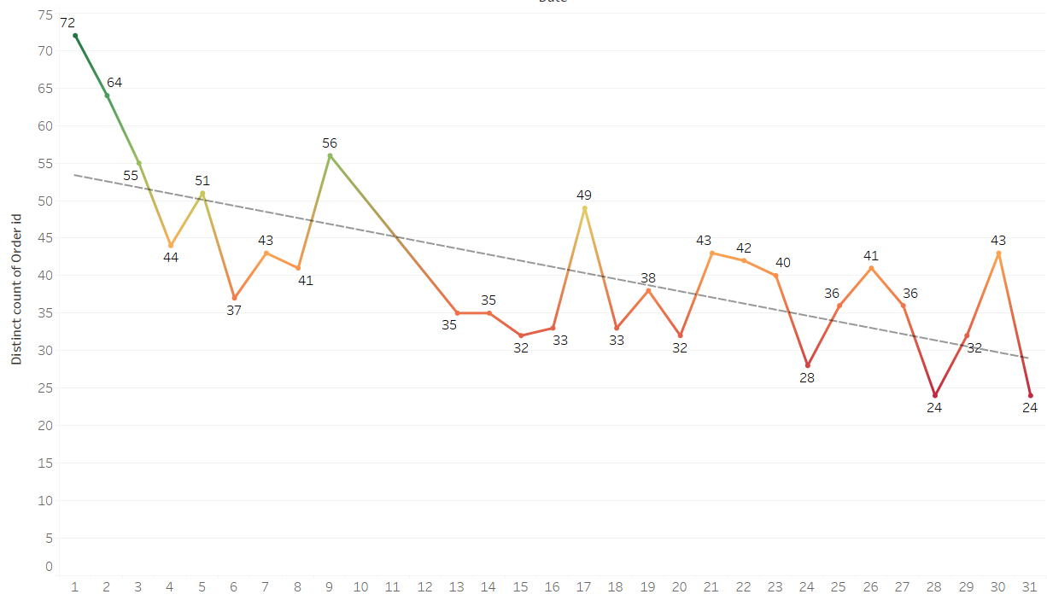
Day wise trend
Observed high number of orders placed during middle of the month and start of month is low and it reduced at end of month.
Starts slowly, get strong in the middle and decline during the end of month

Slide 10
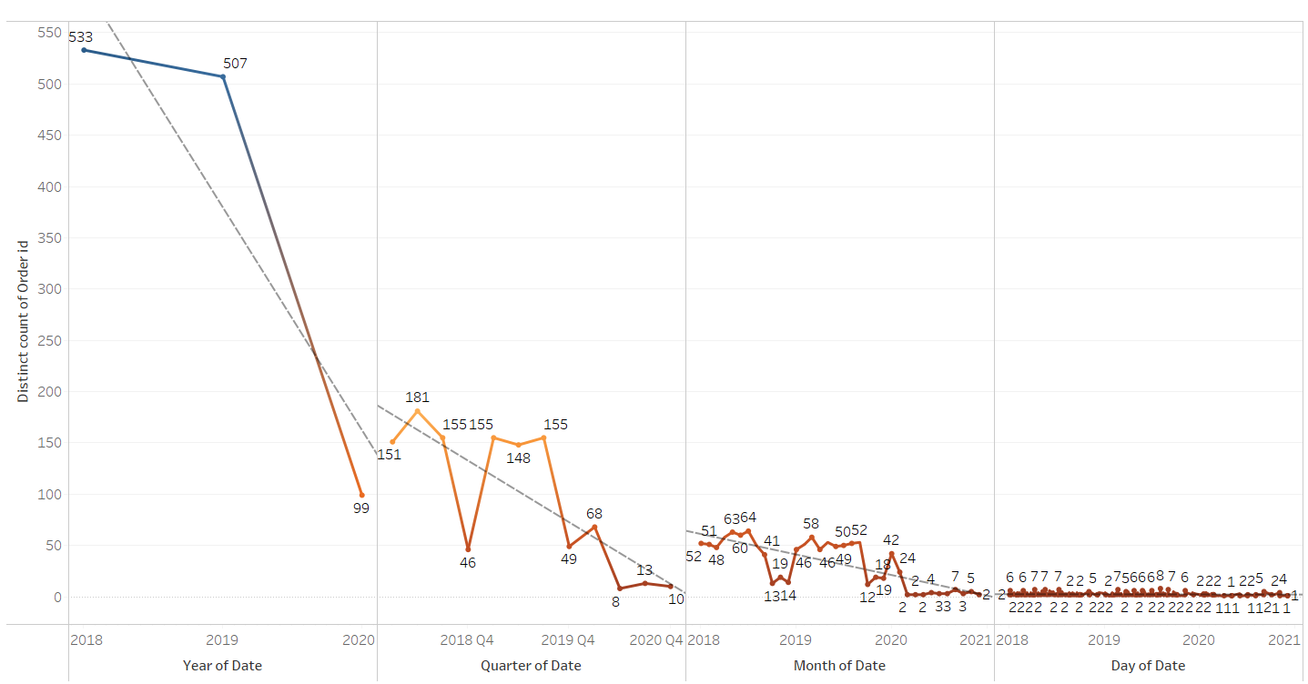
Overall trend
Sales trend per different time period:
1) Yearly trend in sales decreasing from 2018 to 2020 with 2018 having highest sales.
2) Quarterly & Monthly sales indicates declining trend
3) No Trend and Seasonality.
4) Sales decrease in Q4 across the years as per the data given in the dataset.

Slide 11
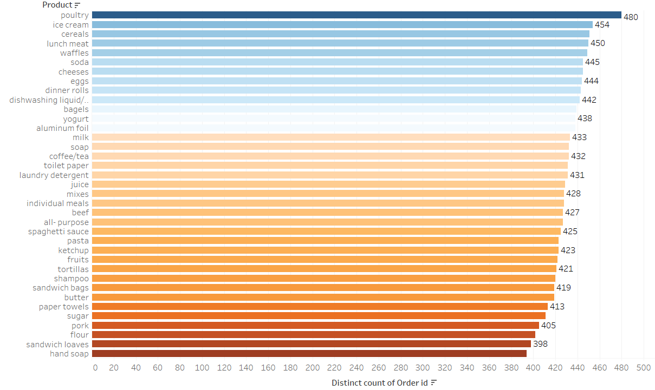
PRODUCTS COUNT
Observed highest number of orders are for product Poultry and lowest number of orders are for product hand soap

Slide 12
MARKET BASKET ANALYSIS
Market Basket Analysis is a technique which identifies the strength of association between pairs
of products purchased together and identify patterns of co-occurrence. A co- occurrence is when
two or more things take place together.
Market Basket Analysis creates If-Then scenario rules, for example, if item A is purchased then
item B is likely to be purchased. The rules are probabilistic in nature, or in other words, they are
derived from the frequencies of co-occurrence in the observations. Frequency is the proportion of
baskets that contain the items of interest. The rules can be used in pricing strategies, product
placement, and various types of cross-selling strategies. In order to make it easier to understand,
think of Market Basket Analysis in terms of shopping at a supermarket. Market Basket Analysis
takes data at transaction level, which lists all items bought by a customer in a single purchase.
The technique determines relationships of what products were purchased with which other
product(s). These relationships are then used to build profiles containing If-Then rules of the
items purchased. The rules could be written as If {A} Then {B}
The If part of the rule (the {A} above) is known as the antecedent and the THEN part of the rule is
known as the consequent (the {B} above).
The antecedent is the condition, and the consequent is the result. The association rule has three
measures that express the degree of confidence in the rule, Support, Confidence, and Lift.

Slide 13
Threshold Values
Support: Its the default popularity of an item. In mathematical terms, the support of item A is nothing but the ratio of transactions involving A to the total number of transactions.
Confidence: Likelihood that customer who bought both A and B. Its divides the number of transactions involving both A and B by the number of transactions involving B.
Lift : Increase in the sale of A when you sell B.

Slide 14

MBA analysis using KNIME
Node Name | Description
Read CSV | Read the CSV file
Data Explorer | Explore the data parameters
GroupBy | GroupBy OrderID
Cell Splitter | Convert the products data to set.
Association Rule Learner | Market Basket Analysis to generate the Frequent/Item List
Excel Extract | Extract the Frequent/Item List to Excel.

Slide 15
MBA – DATA LOAD
There are rows are now 1,139 as compared to our dataset it was 20,641
This will help us classify the products for our further Market Basket Analysis

Slide 16
ASSOCIATIONS IDENTIFIED

Slide 17
INSIGHTS & RECOMMENDATIONS
If [eggs, ice cream, pasta, lunch meat..] is purchased THEN paper towels also purchased. This rule has a confidence of 79.5%.
If [dishwashing liquid/detergent, cheeses, waffles, soda ] is purchased then flour will also be purchased. This rule has a confidence of 72.9%.
Higher the lift value higher the probability that customer will purchase that item.
If [eggs, ice cream, pasta, lunch meat..] is purchased THEN paper towels also purchased. This rule has a confidence of 79.5% from this rule we can create a combo of 3 towels (if you buy 2 towels listed items you will get 1 free or 20 % of on third ).
If [butter, aluminum foil, soap]is purchased THEN Ketchup also purchased. This rule has a confidence of 67.6% along with lift value of 1.822 :- from this rule we can make that if you buy 500 gm. Ketchup bottle along with above listed items you will get 10 ketchup sachet free .
Above type of recommendations/Lucrative offers will generate more sales thus increase the revenue of the Grocery Store.
Management can also pay attention to below listed product(s) combos for discounts & offers :
o Buy 5 KG laundry detergent , Get 2 bathing soaps free or 20% discount on flour
o sandwich bags, sugar, all- purpose, ketchup
o beef, butter, cereals – overall amount 5% discount

